Slide 1
Basics of Cost-Effectiveness Analysis
PubH 6717
Karen M. Kuntz
Session 10
Notes:
1

Slide 2
Cost-Effectiveness Analysis
Relevant when alternative options have different costs and health consequences
Costs are valued in monetary terms (e.g., US$)
Benefits are valued in terms of clinical outcomes (e.g., cases prevented or cured, lives saved, years of life gained, quality-adjusted life years gained)
Results reported as a cost-effectiveness ratio

Slide 3
Cost-Effectiveness Ratio
Net increase in health care cost
Net gain in health effect

Slide 4
A Special Case
Net increase in health care cost
Net gain in quality-adjusted life years
Cost-Utility Analysis

Slide 5
Two Types of Policy Decisions
Decision #1
Decision #2
Malaria Deaths Prevention program
Depression Screening program
Safe Motherhood program
Child Vaccination program
Cardiovascular Disease program
Insecticide-treated nets
Spray houses
Drug prophylaxis

Slide 6
Two Types of Policy Decisions
Decision #1
Decision #2
Malaria Deaths Prevention program
Depression Screening program
Safe Motherhood program
Child Vaccination program
Cardiovascular Disease program
Insecticide-treated nets
Spray houses
Drug prophylaxis
Technical efficiency
Allocative efficiency
Notes:
Technical or Productive efficiency (how to do it?)
what is the best way to deliver a specific health service or reduce mortality from a specific disease?
Allocative efficiency (what to do?)
which health services should we deliver?

Slide 7
Introduction to Resource Allocation
How can we measure the relative priority of these various health programs that compete for limited resources?

Slide 8
Two Types of Policy Decisions
Decision #1
Decision #2
Malaria Deaths Prevention program
Depression Screening program
Safe Motherhood program
Child Vaccination program
Cardiovascular Disease program
Insecticide-treated nets
Spray houses
Drug prophylaxis
“Competing Choice”
“Shopping Spree”
Notes:
Technical or Productive efficiency (how to do it?)
what is the best way to deliver a specific health service or reduce mortality from a specific disease?
Allocative efficiency (what to do?)
which health services should we deliver?

Slide 9
Assumptions for Shopping Spree (1)
There are a number of available programs for which net costs and net effectiveness have been evaluated
There is a limited budget – total net cost of programs selected cannot exceed this amount
Objective is to maximize total net effectiveness of programs selected
Any combination of programs is feasible (but limited by budget constraint)
Notes:
4

Slide 10
Assumptions for Shopping Spree (2)
5. Net cost of any program does not depend on which other programs are also selected
6. Net effectiveness of any program does not depend upon which other programs are selected
7. All programs are divisible, with proportional costs and effectiveness
Notes:
4

Slide 11
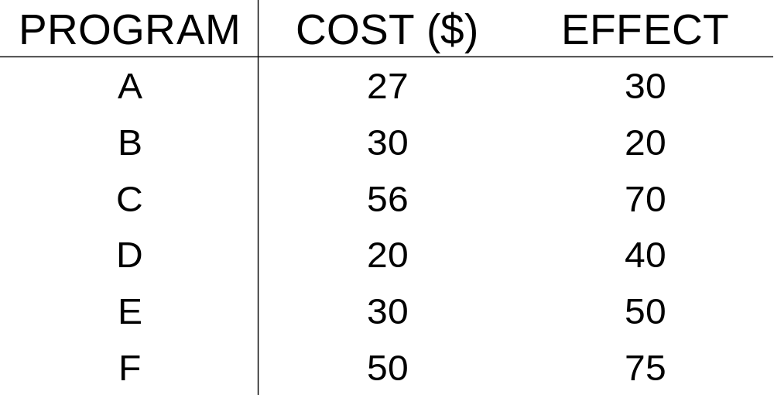
Example
Budget $100
Notes:
6
A set of policies
net cost
net effectiveness
A health objective
A constrained resource
Which get funding?
Which do not?

Slide 12
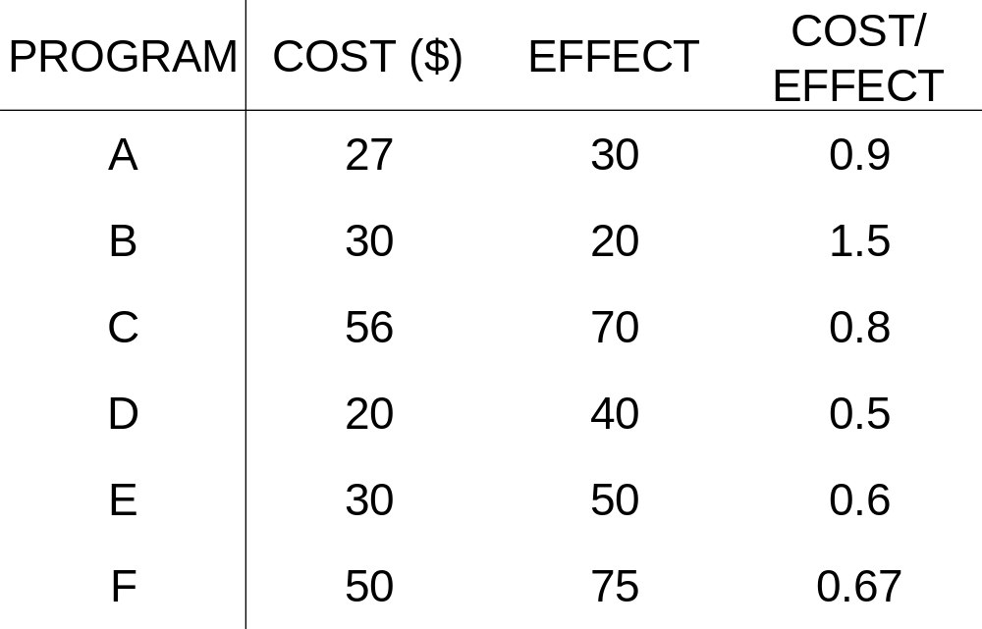
Divide Net Cost by Net Effect
Notes:
8

Slide 13
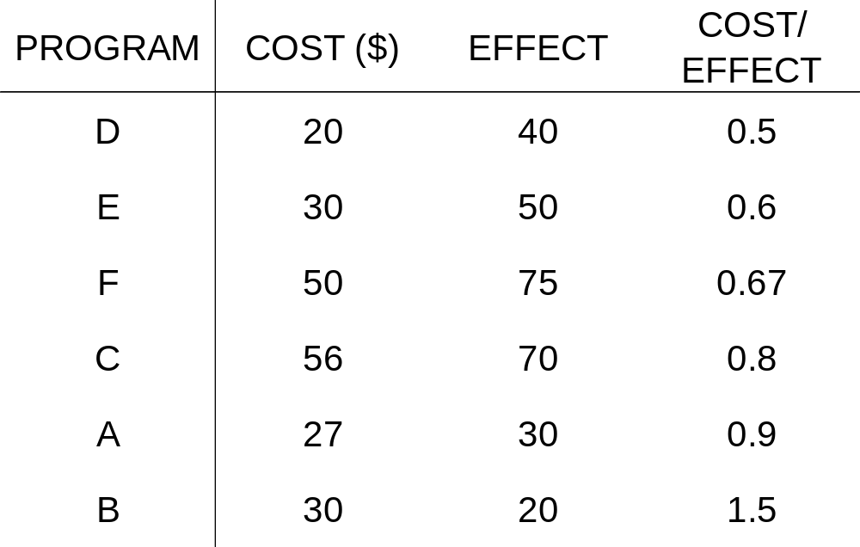
Order from lowest to highest ratio
Notes:
9

Slide 14
Accumulate costs & effects
Program | Cost ($) | Effect | Cost/ Effect | Cum. Cost | Cum. Effect
D | 20 | 40 | 0.5 | 20 | 40
E | 30 | 50 | 0.6 | 50 | 90
F | 50 | 75 | 0.667 | 100 | 165
C | 56 | 70 | 0.8 | 156 | 235
A | 27 | 30 | 0.9 | 183 | 265
B | 30 | 20 | 1.5 | 213 | 285
Program | Cost ($) | Effect | Cost/ Effect | Cum. Cost | Cum. Effect
D | 20 | 40 | 0.5 | 20 | 40
E | 30 | 50 | 0.6 | 50 | 90
F | 50 | 75 |  | 100 | 165
C | 56 | 70 | 0.8 | 156 | 235
A | 27 | 30 | 0.9 | 183 | 265
B | 30 | 20 | 1.5 | 213 | 285
Notes:
10

Slide 15
Spend the budget
Program | Cost ($) | Effect | Cost/ Effect | Cum. Cost | Cum. Effect
D | 20 | 40 | 0.5 | 20 | 40
E | 30 | 50 | 0.6 | 50 | 90
F | 50 | 75 | 0.667 | 100 | 165
C | 56 | 70 | 0.8 | 156 | 235
A | 27 | 30 | 0.9 | 183 | 265
B | 30 | 20 | 1.5 | 213 | 285
Program | Cost ($) | Effect | Cost/ Effect | Cum. Cost | Cum. Effect
D | 20 | 40 | 0.5 | 20 | 40
E | 30 | 50 | 0.6 | 50 | 90
F | 50 | 75 |  | 100 | 165
C | 56 | 70 | 0.8 | 156 | 235
A | 27 | 30 | 0.9 | 183 | 265
B | 30 | 20 | 1.5 | 213 | 285
Budget Programs Effect Threshold
$100 D,E,F 165 0.667
Notes:
10

Slide 16
Spend the budget
Program | Cost ($) | Effect | Cost/ Effect | Cum. Cost | Cum. Effect
D | 20 | 40 | 0.5 | 20 | 40
E | 30 | 50 | 0.6 | 50 | 90
F | 50 | 75 | 0.667 | 100 | 165
C | 56 | 70 | 0.8 | 156 | 235
A | 27 | 30 | 0.9 | 183 | 265
B | 30 | 20 | 1.5 | 213 | 285
Program | Cost ($) | Effect | Cost/ Effect | Cum. Cost | Cum. Effect
D | 20 | 40 | 0.5 | 20 | 40
E | 30 | 50 | 0.6 | 50 | 90
F | 50 | 75 |  | 100 | 165
C | 56 | 70 | 0.8 | 156 | 235
A | 27 | 30 | 0.9 | 183 | 265
B | 30 | 20 | 1.5 | 213 | 285
Budget Programs Effect Threshold
$100 D,E,F 165 0.667
$183 D,E,F,C,A 265 0.9
Notes:
10

Slide 17
Spend the budget
Program | Cost ($) | Effect | Cost/ Effect | Cum. Cost | Cum. Effect
D | 20 | 40 | 0.5 | 20 | 40
E | 30 | 50 | 0.6 | 50 | 90
F | 50 | 75 | 0.667 | 100 | 165
C | 56 | 70 | 0.8 | 156 | 235
A | 27 | 30 | 0.9 | 183 | 265
B | 30 | 20 | 1.5 | 213 | 285
Program | Cost ($) | Effect | Cost/ Effect | Cum. Cost | Cum. Effect
D | 20 | 40 | 0.5 | 20 | 40
E | 30 | 50 | 0.6 | 50 | 90
F | 50 | 75 |  | 100 | 165
C | 56 | 70 | 0.8 | 156 | 235
A | 27 | 30 | 0.9 | 183 | 265
B | 30 | 20 | 1.5 | 213 | 285
Budget Programs Effect Threshold
$100 D,E,F 165 0.667
$183 D,E,F,C,A 265 0.9
$150 D,E,F,(50/56)C 227.5 0.8
Notes:
10

Slide 18
Solution for Shopping Spree Problem
Rule out programs with C > 0 and E < 0
Rule in programs with C < 0 and E > 0
Rank remaining programs in ascending order of cost-effectiveness ratios
Select programs from the rank list until budget is exhausted

Slide 19
Should Program H be Funded?
Net Cost = $50
Net Effect = 70
Costs/Effect = 0.714

Slide 20
Should New Program H be Included?
Program | Cost ($) | Effect | Cost/ Effect | Cum. Cost | Cum. Effect
D | 20 | 40 | 0.5 | 20 | 40
E | 30 | 50 | 0.6 | 50 | 90
F | 50 | 75 | 0.667 | 100 | 165
C | 56 | 70 | 0.8
A | 27 | 30
B | 30 | 20
Program
Cost ($)
Effect
Cost/
Effect
Cum.
Cost
Cum.
Effect
D
20
40
0.5
20
40
E
30
50
0.6
50
90
F
50
75
100
165
H
C
56
A
27
30
B
30
20
Budget Programs Effect Threshold
no
$100 D,E,F 165 0.667
$150 D,E,F,(50/56)C 227.5 0.8
yes
Notes:
10

Slide 21
Threshold Cost-Effectiveness Ratio
Cost-effectiveness ratio of the last included program selected before budget exhausted
Represents the standard against which programs that make claims against the budget can be judged
As budget rises what happens to the cost-effectiveness threshold?

Slide 22
Competing Choice Problem
We will make an additional assumption to the cost-effectiveness algorithm we used for the “shopping spree”
  Some programs (e.g., different interventions to prevent malaria) will not be independent and will be mutually exclusive
Notes:
4

Slide 23
General Assumptions
Same as Shopping Spree, except…
Some programs are mutually exclusive (i.e., if you select X₁, then you cannot select X₂, X₃, X₄, etc.)
Divisibility: It is possible to offer different competing choice alternatives to different fractions of the target population (e.g., 50% X₁, 50% X₂)

Slide 24
Example 1: Budget $180
Program | Cost ($) | Effect | Cost/ Effect | Cum. Cost | Cum. Effect
D | 20 | 40 | 0.5 | 20 | 40
E | 30 | 50 | 0.6 | 50 | 90
F | 50 | 75 | 0.67 | 100 | 165
C | 56 | 70 | 0.8 | 156 | 235
A | 27 | 30 | 0.9 | 183 | 265
B | 30 | 20 | 1.5 | 213 | 285
Budget Programs Effect Threshold
$180 D,E,F,C,(24/27)A 261.7 0.9
Notes:
10
Best you can do is D,E,F,C and 24/27A
Cost=180
Benefit 261.7
Threshold=0.9
In the absence of any other programs the best you can do is 261.7 given this budget constraint.
Threshold Ratio:
Cost-effectiveness ratio of the last included program selected before budget exhausted
Represents the standard against which programs that make claims against the budget can be judged
Shadow price of an explicit budget constraint
Opportunity cost in the absence of an explicit budget constraint
Comparison with other health programs
Inference of cost-effectiveness criteria from prior decisions
Cost-benefit methods
Rules of thumb

Slide 25
Which H Program should we fund, if any (Budget = $180)?
Program Cost ($) Effect
H1 60 80
H2 40 65
H3 55 70
H4 22 40
H5 45 60
Best we can do without Program H is D,E,F,C, and (24/27)A = 261.7. Can we do better?

Slide 26
Do C/E Ratios Help?
Program Cost ($) Effect C/E
H1 60 80 0.75
H2 40 65 0.62
H3 55 70 0.79
H4 22 40 0.55
H5 45 60 0.75

Slide 27
Add H4 (lowest C/E ratio)
Program | Cost ($) | Effect | C/E | Cum. Cost |  | Cum. Effect
D | 20 | 40 | 0.5 |  | 20 |  | 40
H4 | 22 | 40 | 0.55 |  | 42 |  | 80
E | 30 | 50 | 0.6 |  | 72 |  | 130
F | 50 | 75 | 0.67 |  | 122 |  | 205
C | 56 | 70 | 0.8 |  | 178 |  | 275
A | 27 | 30 | 0.9 |  | 205 |  | 305
B | 30 | 20 | 1.5
Best we can do is Program D,H4,E,F,C,(2/27)A = 277.2.
Notes:
10
H4 : Add in the program with the “lowest CE ratio”: Best we can do is 277.2
Order of trial and error method:
H4 277.2
H3 266.2
H2 280

Slide 28
Add H3 (closest to threshold)
Program | Cost ($) | Effect | C/E | Cum. Cost |  | Cum. Effect
D | 20 | 40 | 0.5 |  | 20 |  | 40
E | 30 | 50 | 0.6 |  | 50 |  | 90
F | 50 | 75 | 0.67 |  | 100 |  | 165
H3 | 55 | 70 | 0.79 |  | 155 |  | 235
C | 56 | 70 | 0.8 |  | 211 |  | 305
A | 27 | 30 | 0.9
B | 30 | 20 | 1.5
Best we can do is Program D,E,F,H3,(25/56)C = 266.25.
Notes:
10
H3 : Add in the program with the “CE ratio closest to the threshold”: Best we can do is 266.25

Slide 29
Let’s try adding H2
Program | Cost ($) | Effect | C/E | Cum. Cost |  | Cum. Effect
D | 20 | 40 | 0.5 |  | 20 |  | 40
E | 30 | 50 | 0.6 |  | 50 |  | 90
H2 | 40 | 65 | 0.62 |  | 90 |  | 155
F | 50 | 75 | 0.67 |  | 140 |  | 230
C | 56 | 70 | 0.8 |  | 196 |  | 300
A | 27 | 30 | 0.9
B | 30 | 20 | 1.5
Best we can do is Program D,E,H2,F,(40/56)C = 280.
Notes:
10
H2 Best we can do is 280

Slide 30
Incremental Cost-Effectiveness Analysis
Program Costs ($) Effect
H1 60 80
H2 40 65
H3 55 70
H4 22 40
H5 45 60
H5 costs more and is less effective than H2 (dominated)!

Slide 31
Order in terms of increasing costs and effectiveness
Program | Cost ($) | Effect | Avg C/E | Inc. Costs | Inc. Eff. | Inc. C/E
H4 | 22 | 40 | 0.55 | -- | -- | --
H2 | 40 | 65 | 0.62 | 18 | 25 | 0.72
H3 | 55 | 70 | 0.79 | 15 | 5 | 3.0
H1 | 60 | 80 | 0.75 | 5 | 10 | 0.5
Notes:
10
Steps
1. Rule out strongly dominated options
2. Reorder from lowest to highest total costs such that the remaining options sequentially cost more and deliver more. Question: Are the benefits worth the costs?
3. Calculate the incremental CE ratios and look at the pattern. To calculate the FIRST CE ratio need to answer the question: What is the baseline comparator? Is there a no cost and no benefit “do nothing” option? (State the assumption we are making here)
4. What do you notice about the incremental CE ratio of H3? Define weak dominance. Rule out weakly dominated options.
5. Recalculate the CE ratios

Slide 32
Are incremental CE ratios increasing?
Program | Cost ($) | Effect | Avg C/E | Inc. Costs | Inc. Eff. | Inc. C/E
H4 | 22 | 40 | 0.55 | -- | -- | --
H2 | 40 | 65 | 0.62 | 18 | 25 | 0.72
H3 | 55 | 70 | 0.79 | 15 | 5 | 3.0
H1 | 60 | 80 | 0.75 | 5 | 10 | 0.5
H3 eliminated by extended (or weak) dominance.
Notes:
10
Steps
1. Rule out strongly dominated options
2. Reorder from lowest to highest total costs such that the remaining options sequentially cost more and deliver more. Question: Are the benefits worth the costs?
3. Calculate the incremental CE ratios and look at the pattern. To calculate the FIRST CE ratio need to answer the question: What is the baseline comparator? Is there a no cost and no benefit “do nothing” option? (State the assumption we are making here)
4. What do you notice about the incremental CE ratio of H3? Define weak dominance. Rule out weakly dominated options.
5. Recalculate the CE ratios

Slide 33
Recalculate ICERs
Program | Cost ($) | Effect | Avg C/E | Inc. Costs | Inc. Eff. | Inc. C/E
H4 | 22 | 40 | 0.55 |  |  | --
H2 | 40 | 65 | 0.615 | 18 | 25 | 0.72
H1 | 60 | 80 | 0.75 | 20 | 15 | 1.33
These are the ratios to compare to the threshold
Notes:
10
H3 eliminated by weak dominance
Recalculate incremental ratios
These are the ratios to compare to the threshold

Slide 34
Recalculate ICERs
Program | Cost ($) | Effect | Avg C/E | Inc. Costs | Inc. Eff. | Inc. C/E
H4 | 22 | 40 | 0.55 |  |  | --
H2 | 40 | 65 | 0.615 | 18 | 25 | 0.72
H1 | 60 | 80 | 0.75 | 20 | 15 | 1.33
These ratios are meaningless!
Notes:
10
H3 eliminated by weak dominance
Recalculate incremental ratios
These are the ratios to compare to the threshold

Slide 35
Back to the Example
Program | Cost ($) | Effect | C/E | Cum. Cost |  | Cum. Effect
D | 20 | 40 | 0.5 |  | 20 |  | 40
E | 30 | 50 | 0.6 |  | 50 |  | 90
F | 50 | 75 | 0.67 |  | 100 |  | 165
H2 | 40 | 65 | 0.72 |  | 140 |  | 230
C | 56 | 70 | 0.8 |  | 196 |  | 300
A | 27 | 30 | 0.9
B | 30 | 20 | 1.5
Maximum benefit is obtained by implementing D,E,H2,F,(40/56)C = 280.
Notes:
10
H2 Best we can do is 280

Slide 36
Results of Competing Choice (1)
75
H1
H3
50
H5
Cost
H2
25
H4
“Efficient Frontier”
0
0
25
50
75
100
Benefit
Notes:
The cost-effectiveness of moving from one screening strategy to a more costly alternative is represented by the difference in cost divided by the difference in life expectancy associated with the two strategies. Strategies lying on the efficiency curve dominate those lying to the left of the curve because they are more effective, and either cost less or have a more attractive cost-effectiveness ratio, than the next best strategy. An incremental cost-effectiveness ratio is calculated for each nondominated strategy. What do the slopes represent? The slope of the line connecting the two screening strategies under comparison is the incremental CE ratio; this slope will be flatter when the net gain in life expectancy per dollar is greater. (Realize when the efficiency curve is plotted with cost on the x axis the slope will be steeper when the net gain in LE per dollar is greater and the inverse of the slope is the CE ratio)
Slopes represent incremental cost-effectiveness ratios
South (low cost) and East (high benefit) is desirable – Efficient Frontier
Points to the left of the curve are dominated
Strong dominance: H5 costs more than H2 but delivers less benefit
Weak dominance: Combination of H2 and H1 delivers greater benefit than H3 at the same cost

Slide 37
Results of Competing Choice (2)
75
H3 weakly dominated
H1
H3
50
H5
Cost
H2
H5 strongly dominated
25
H4
“Efficient Frontier”
0
0
25
50
75
100
Benefit
Notes:
The cost-effectiveness of moving from one screening strategy to a more costly alternative is represented by the difference in cost divided by the difference in life expectancy associated with the two strategies. Strategies lying on the efficiency curve dominate those lying to the left of the curve because they are more effective, and either cost less or have a more attractive cost-effectiveness ratio, than the next best strategy. An incremental cost-effectiveness ratio is calculated for each nondominated strategy. What do the slopes represent? The slope of the line connecting the two screening strategies under comparison is the incremental CE ratio; this slope will be flatter when the net gain in life expectancy per dollar is greater. (Realize when the efficiency curve is plotted with cost on the x axis the slope will be steeper when the net gain in LE per dollar is greater and the inverse of the slope is the CE ratio)
Slopes represent incremental cost-effectiveness ratios
South (low cost) and East (high benefit) is desirable – Efficient Frontier
Points to the left of the curve are dominated
Strong dominance: H5 costs more than H2 but delivers less benefit
Weak dominance: Combination of H2 and H1 delivers greater benefit than H3 at the same cost

Slide 38
Competing Choice Solution
Arrange the competing programs in increasing order of cost
Exclude the strongly dominated options
Calculate incremental C/E for remaining options
Exclude the weakly dominated options
Recalculate incremental C/E for remaining options
Repeat until remaining options are in increasing order of C/E

Slide 39
Net Health Benefit Method
Determine the threshold CE ratio (λ)
For each competing option, compute the net health benefit (NHB):
NHB = Benefit – Cost * (1/λ)
Select the option with greatest NHB
Notes:
Must state the threshold a priori
Threshold Ratio:
Cost-effectiveness ratio of the last included program selected before budget exhausted
Represents the standard against which programs that make claims against the budget can be judged
Shadow price of an explicit budget constraint
Opportunity cost in the absence of an explicit budget constraint
Comparison with other health programs
Inference of cost-effectiveness criteria from prior decisions
Cost-benefit methods
Rules of thumb
There are particular advantages to not having a ratio to deal with as the result of analysis when conducting uncertainty analyses

Slide 40
NHB Methods
Budget = $180 (Threshold = 0.9)
Program | Cost ($) | Effect | NHB
H1 | 60 | 80 | 13.3
H2 | 40 | 65 | 20.6
H3 | 55 | 70 | 8.9
H4 | 22 | 40 | 15.6
H5 | 45 | 60 | 10.0
Notes:
10
Maximize the “net imputed value”
= [threshold cost per unit benefit * benefits] – [cost]
= [implicit value of benefits] – [costs]
H1 (0.9)(80)-(60)=12
H2 (0.9)(65)-(40)=18.5
H3 =8
H4 =14
H5 =9

Slide 41
Net Health Benefit
For a given C/E threshold, the competing choice alternative with the greatest net health benefit (NHB) is the most cost-effective option at that budget constraint.
The procedure of comparing NHB at a fixed C/E threshold is equivalent to applying the rule of selecting the largest competing alternative whose incremental C/E ratio is below the C/E threshold.

